Slide 1
Instruction manual for using of the platform Negometrix for the companies
Way of creating profile, submitting offer, participating in е-auction

Slide 2
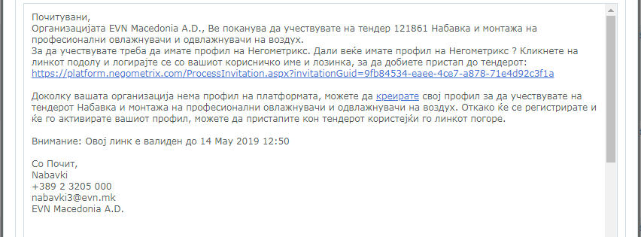
Instruction manual for Negometrix
I. Creating profile in Negometrix
1. Before you create a profile you receive an e-mail from our side with text like in the picture. You should use the platform through the browser Google Chrome.
2. If you don’t have profile on Negometrix you click “Create” your profile on the platform.
3. If you already have profile on Negometrix, you click on the link from the picture below. With clicking automatically the platform will open the tender.

Slide 3
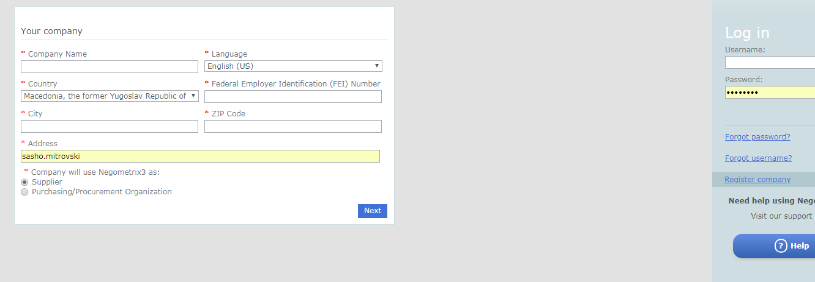
With clicking on the button “Create” it opens new window in the platform Negometrix. You Click on the button “Register company” and it opens new window where you should fill in all the information for your company. You should fill in information for the name of the company, language that you want to operate inside Negometrix, country, VAT number, city, zip code, e-mail address, you select that you want to be supplier and click “Next”

Slide 4
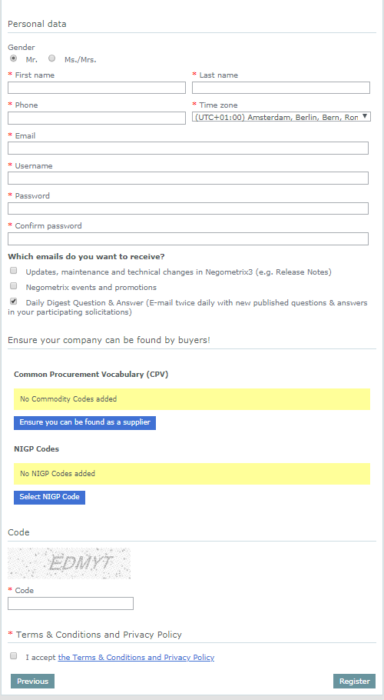
II. Entering data for the company
After you click Next, a new window is open where you should enter all the date for your company, including username and password for your profile(with this you will log into Negometrix).
At the button “Common Procurement Vocabulary (CPV), you need to select your business activity for which you are interested to be selected like supppier. You click on the button “Ensure you can be found as a supplier”. At the button “NIGP codes” there is not need to select anything. You enter the “protection code”, you check that you accept the terms and conditions and click on the button “Register”. After you click the button “Register” Откако ќе го кликнете копчето “Register”, if the registration is successfull you should receive the message on the pichture.
доколку е успешна регистрацијата треба да ја добиете пораката подолу.

Slide 5
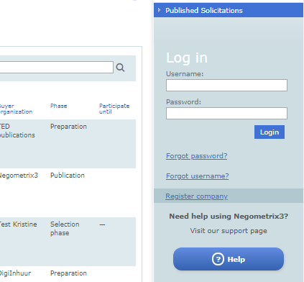
After you register your company, you will receive e-mail where you will have link for final confirmation of this registration. You click on this link and the registration is activated. With this you go automatically on the Negometrix web page.
In the right part of the screen you have 2 boxes for entering username and password. After you enter them you click “login” and you log on into your profile. If you have forgotten your password or username, you click on the buttons “forgot password / forgot username” from where you can create new.

Slide 6
After you log on, you enter on your profile inside the platform Negometrix.
You have more options like supplier. You can see the “Published solicitations”. In solicitations (Supplier) you can see the tender in which you participate. You can see all the tenders for you like supplier in “Solicitations (Supplier)” . In the option “Messages” are all the messages that you exchange with the buyer for different tenders and regularly you should check your messages. “My profile” is option where you arrange the profile of the administrator of your user like supplier. Through the option “Company” you can arrange the profile of your company. The option “Logout” is for to log out from your profile.

Slide 7
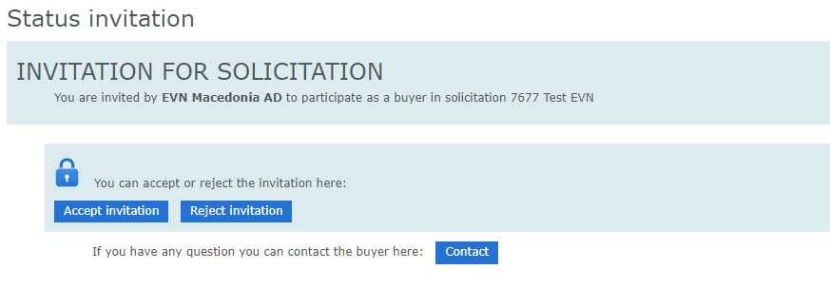
Way of participating in tender - Status
When you receive the e-mail for participating in solicitation(tender), you click the link and you log on the platform Negometrix. You should receive invitation like in the picture below. If you want to accept the invitation you click “Accept invitation”, If you want to reject this invitation you click “Reject invitation”. If you want to contact the buyer (EVN) before accepting the invitation, you can contact Us with clicking the button “Contact”
When you accept the invitation for the tender, you should get information like in the picture below.

Slide 8
Way of working through the profile
When you log on like Seller, in the list of tenders “Solicitations”, you will see the tender for which you have accepted the invitation. The tenders that you are invited through e-mail, you can see them in the option “Solicitation (Supplier). If you want to participate or see the tenders that is published on the whole platform, you can list them in the option “Published solicitation”. For opening the the tender that you have accepted invitation you click the name of it. in this case you click “Test EVN”

Slide 9
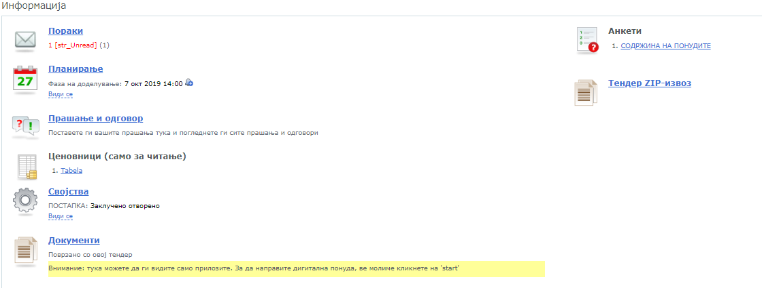
Way of submitting offer - Information
When you open the tender you can see all the information for the specified tender like in the picture below. Way of submitting the offer the offer is through 3 (three) steps. We are starting with “Information”, where you have all the information and documentation and documents for the tender. If we want to start filling the offer we click the button “Start”Доколку сакаме да започнеме со пополнување на понуда го кликаме копчето “ Start”.

Slide 10
Way of submitting offer - Information
In the bottom part of the screen(picture below) you have all the information for the tender: 1. Messages that you exchange with the buyer, 2. Timeframe for the different phases of the tender, 3. Questions and answers, 4. Pricelist, 5. Settings, 6. Documents connected with the tender, 7. Documents that should be submitted together with the offer.
Ovoj sheet e dobar ama treba na da stavi na slika na angliski.

Slide 11
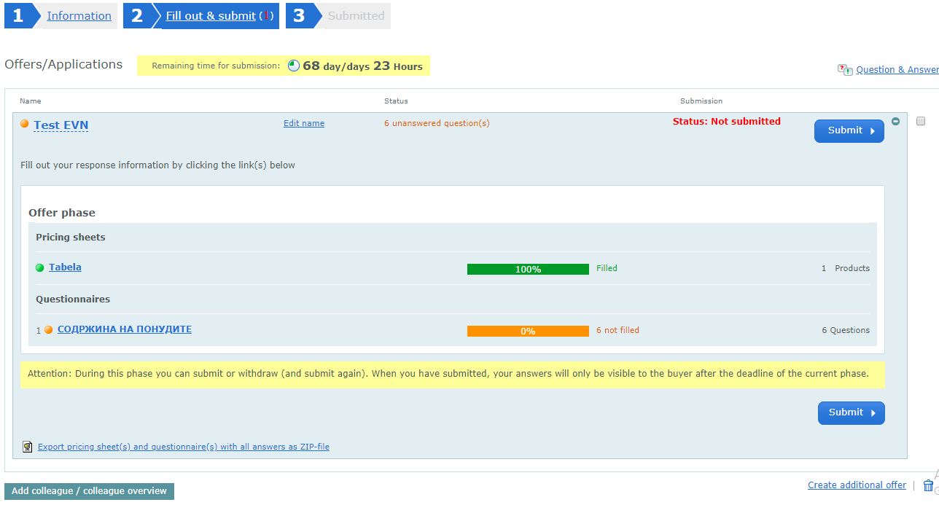
Way of submitting offer - Fill and submit
After you click the button “Start”, you are going to the second step “Fill and submit”, where you submit all the documents that are requested from the buyer and you fill out the price in the option Pricelist/table. In the middle of the picture you have two different colors (green and orange). At the moment the price is filled and we have status “green”, but the other option regarding submitted documents is not filled and is giving status “orange” , it is giving information “6 not filled” that all the documents that are requested are not submitted . Also you have information about the status for the offer “ not submitted”

Slide 12
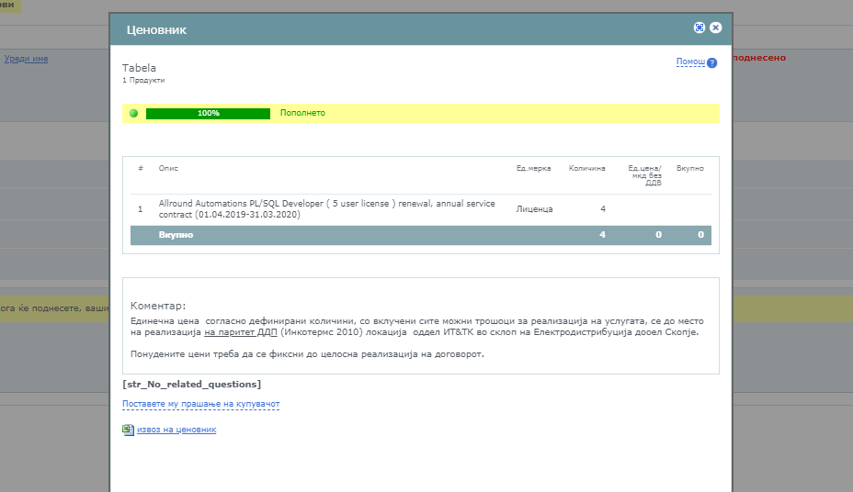
Filling the offer – Entering price
With clicking the option Pricelist/table, you have new window opened where you can we what is the procurement. In this case is only one position, but you can have more positions from one, where you should fill the price for each position. At the option Single price/without VAT you enter the price that you want to offer and you close the window. With this the price is filled and you will get “green’’ color and “filled”. Change picture

Slide 13
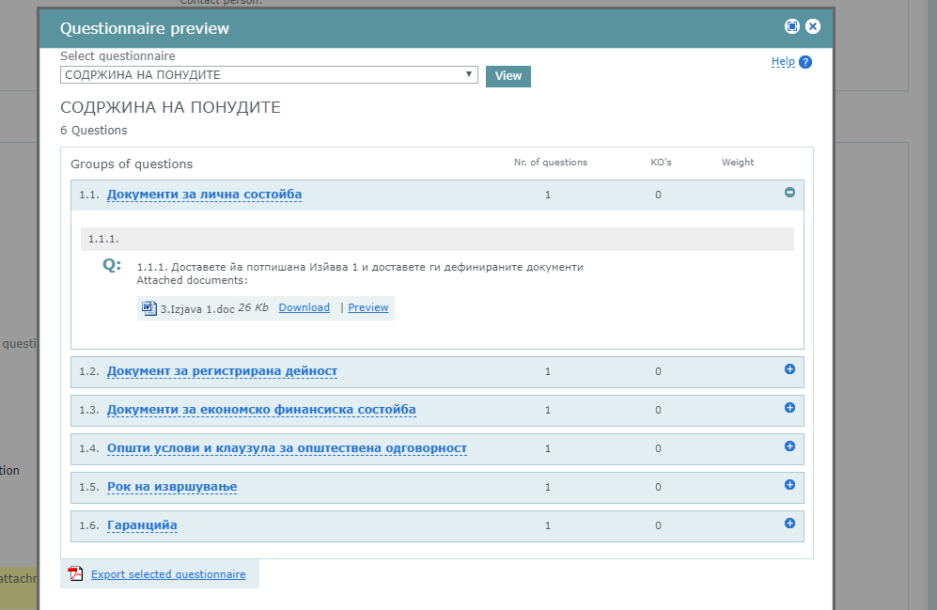
Financial and technical requests – Filling
In Questions you select different options through “Select Questionnaries”. In the picture below you have list of requests from financial and technical aspect. In every different group of questions you have explanation should you upload a document or you just need to give the requested information. The buyer has uploaded documents which you have to download, sign/stamp and upload them again. You take the documents with clicking on the button ‘’Download”, and you upload them with clicking the button “Upload documents from Supplier” . At the end when you finish filling certain group you click “ Save and go to next group”. In this way you fill all the groups that are requested from the buyer. When you fill every group you should get status “Filled”. Change picture

Slide 14
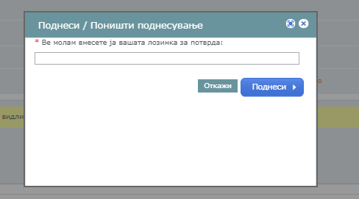
Submitting offer
When you will fill all the groups and the offer, that are requested, you click on the button “Submit” and automatically new window is opened, where you should enter your password for confirming the final submitting of the offer. You enter the password and click “Submit”.

Slide 15
Submitting offer
After submitting the offer, the status is changed and you get information that the offer is submitted and the exact date and time when it is submitted. Until the deadline for submitting offers is not finished, at any time you can withdraw the offer to change something with clicking on the button “ Поништи поднесување”. After you finish with the changes in the same way like before was explained , you submit the offer. Because the offer can be submitted without uploading the requested documents, you should check twice did you uploaded/ filled all the documents that are requested from the buyer.

